Slide 1
LIBRARY MANAGEMENT SYSTEM

Slide 2
ABSTRACT
Library management system is a project which aims in developing a computerized system to maintain all the daily work of library
It is an application for assisting a librarian in managing a book library in a university.
The system would provide basic set of features to add/update books, and manage check in specifications for the systems based on the client's statement of need.
The librarian after logging into his account can generate various options such as adding new book , deleting an existing book , search a book and many more

Slide 3
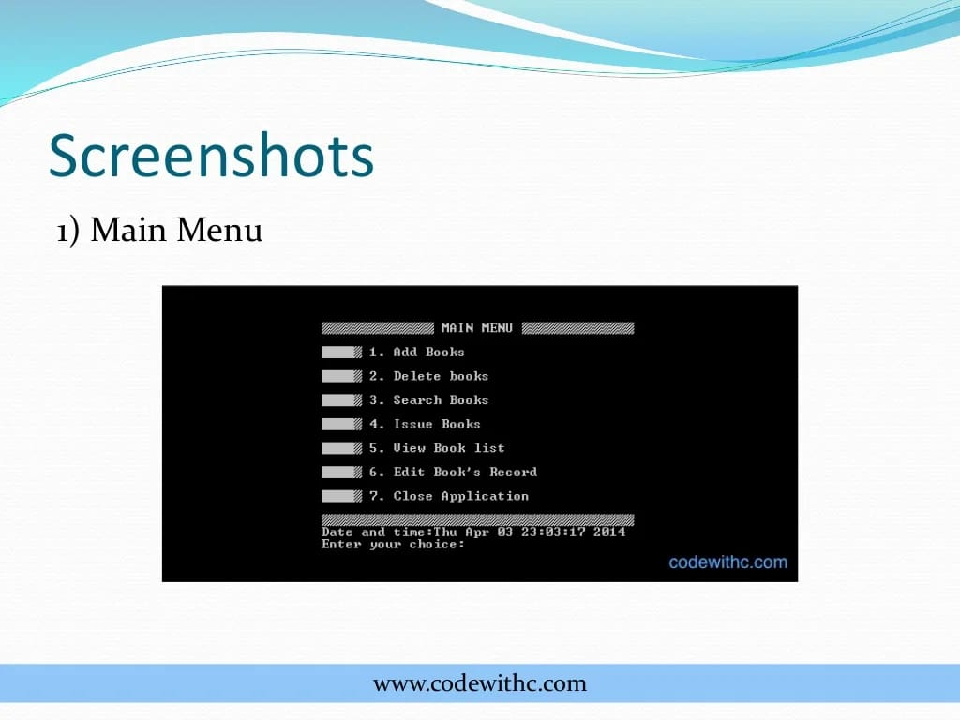
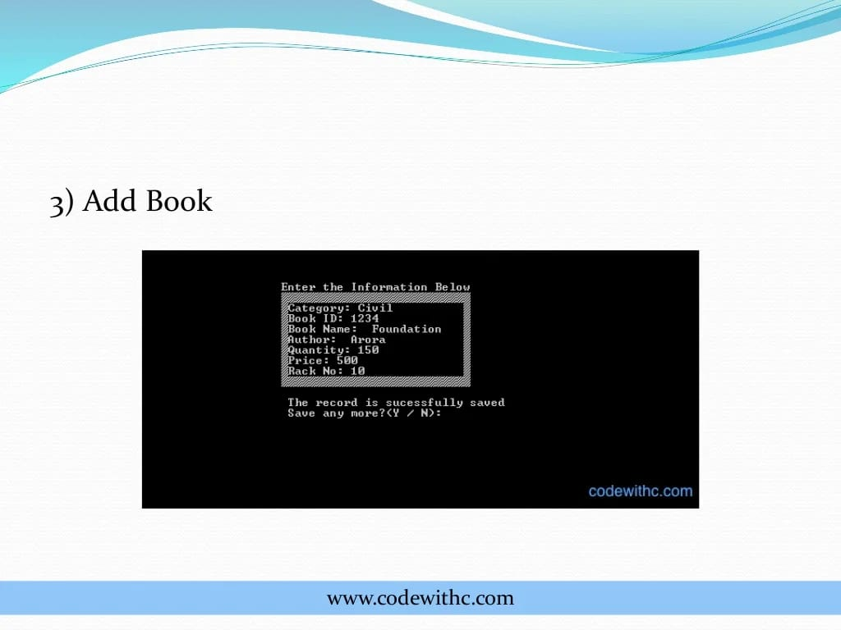
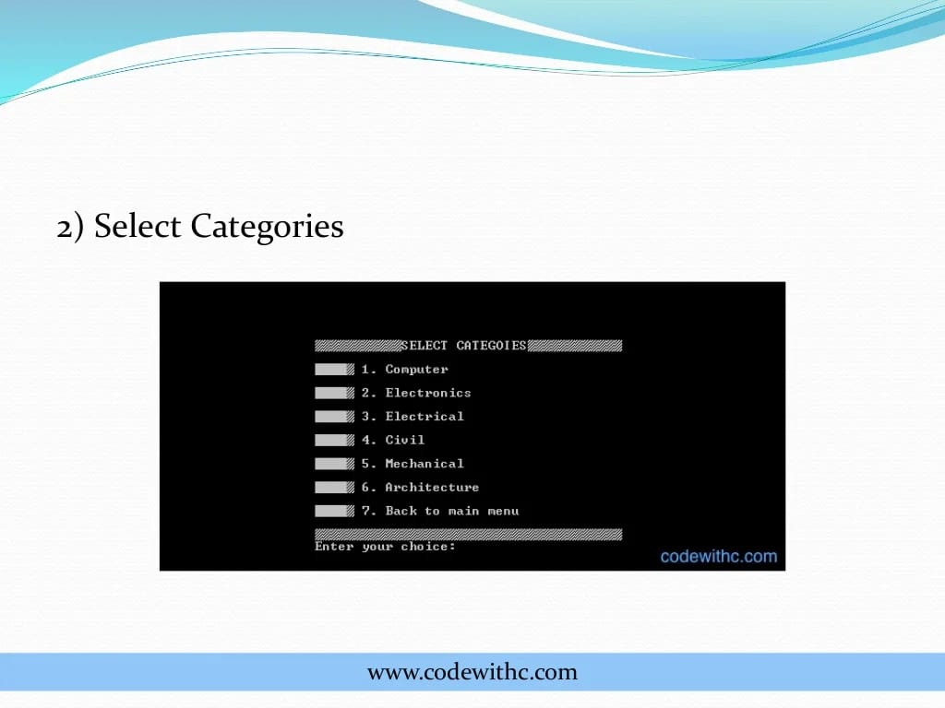

Slide 4
Introduction:-
Library management system is a program to manage library which includes the tasks of:-
Adding new books and magazines/newspapers
Updating books and magazines/newspapers
Deleting books and magazines/newspapers
Issuing books
Collecting books back
Searching for books

Slide 5
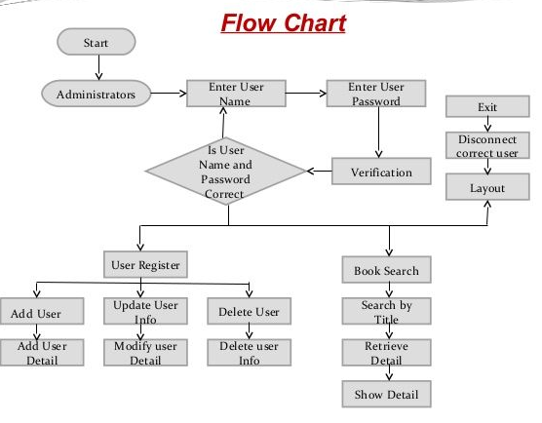

Slide 6
Conclusion:-
The Library Management System allows the user to store the details of books and person
This software allows storing the details of all the data related to library
The implementation of the system will reduce data entry time and provide readily calculated reports
The software takes care of all the requirements of an library and is capable to provide easy and effective storage of information related to books and users

Slide 7
FEATURES:-
The main key features of Library Management System are:
Add books
Return books
Issue books
Delete record of books issued
View record of books issued
Password for administrator to use the system
Books are categorized into different departments

Slide 8
BY:-
HARSH KADAM(20891A1217)
HANISH KUMAR(20891A1251)
RAHUL NAIK(20891A1243)
NAVEEN KUMAR(20891A1252)
GUIDE NAME :-
SHIVRAMA KRISHNA SIR

